Slide 1
Database management systems
lecture 4. Relational model

Slide 2
Data Models
A Database models some portion of the real world.
Data Model is link between user’s view of the world and bits stored in computer.
Many models have been proposed.
We will concentrate on the Relational Model.
Student (sid: string, name: string, login: string, age: integer, gpa:real)
1010111101

Slide 3
Describing Data: Data Models
A data model is a collection of concepts for describing data.
A database schema is a description of a particular collection of data, using a given data model.
The relational model of data is the most widely used model today.
Main concept: relation, basically a table with rows and columns.
Every relation has a schema, which describes the columns, or fields.

Slide 4
Levels of Abstraction
Users
Views describe how users see the data.
Conceptual schema defines logical structure
Physical schema describes the files and indexes used.
(sometimes called the ANSI/SPARC model)
View 1
View 2
View 3
Conceptual Schema
Physical Schema
DB

Slide 5
Data Independence:The Big Breakthrough of the Relational Model
Logical data independence: Protection from changes in logical structure of data.
View 1
View 2
View 3
Conceptual Schema
Physical Schema
DB
Q: Why are these particularly important for DBMS?

Slide 6
Relational Database: Definitions
Relational database: a set of relations.
Relation: made up of 2 parts:
Schema : specifies name of relation, plus name and type of each column.
E.g. Students(sid: string, name: string, login: string, age: integer, gpa: real)
Instance : a table, with rows and columns.
#rows = cardinality
#fields = degree / arity
Can think of a relation as a set of rows or tuples.
i.e., all rows are distinct

Slide 7
Domain
A Domain D is a set of atomic values.
Atomic means that each value in the domain is indivisible as far as the relational model is concerned
It means that if we separate an atomic value, the value itself become meaningless, for example:
SSN
Local_phone_number
Names
Employee_ages

Slide 8
Attribute Types
Each attribute of a relation has a name
The set of allowed values for each attribute is called the domain of the attribute
Attribute values are (normally) required to be atomic; that is, indivisible
E.g. the value of an attribute can be an account number, but cannot be a set of account numbers
Domain is said to be atomic if all its members are atomic
The special value null is a member of every domain
The null value causes complications in the definition of many operations
We shall ignore the effect of null values in our main presentation and consider their effect later

Slide 9
Relation Schema
Relation Schema R, denoted by R(A1, A2,…, An), is made up of relation name R and a list of attributes A1, A2, …,An
Each attribute Ai is the name of a role played by some domain D in the relation schema R.
D is called the domain of Ai and is denoted by dom(Ai)
R is called the name of the relation
The degree of a relation is the number of attributes n of its relation schema

Slide 10
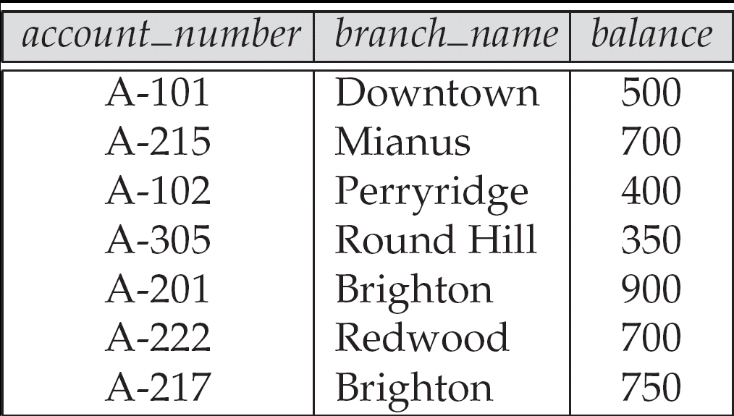
Relations are Unordered
Order of tuples is irrelevant (tuples may be stored in an arbitrary order)
Example: account relation with unordered tuples

Slide 11
Ordering
Ordering of Tuples is a Relation
a relation is defined as a set of tuples.
Mathematically, elements of a set have NO order among them
The ordering indicates first, second, ith, and last records in the file
Hence, the following two relations are identical

Slide 12
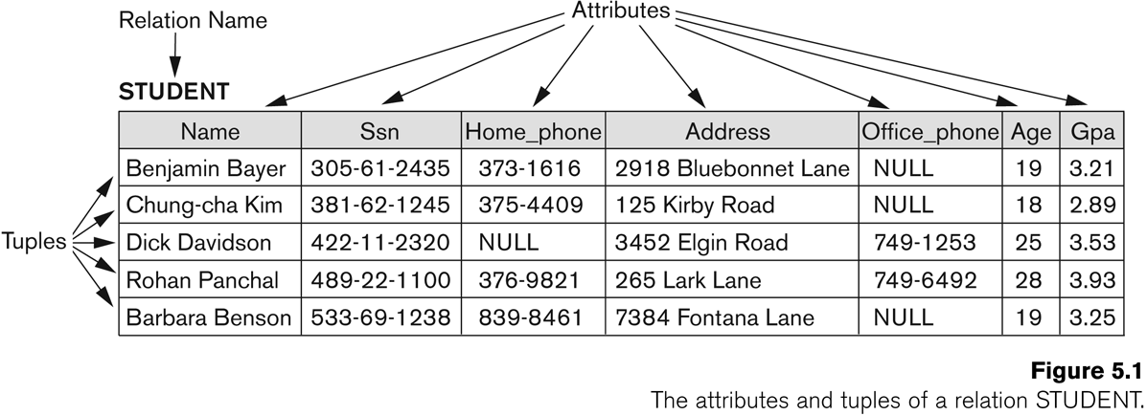
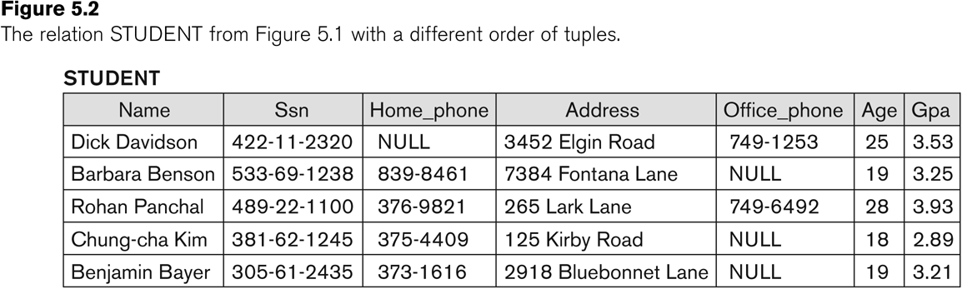
Identical Relations

Slide 13
Values in the Tuples
Each value in a tuple is an atomic value
Hence, composite and multi-valued attributes are not allowed
This model is sometimes called the flat relational model
Much of the theory behind the relational model was developed with this assumption, which is called first normal form assumption

Slide 14
Null in tuples
An important concept is that if NULL values, which are used to represent the values of attributes that may be unknown or may not apply to a tuple

Slide 15
Relational Model Notation
An attribute A can be qualified with the relation name R to which it belongs by using the dot notation R.A
For example, STUDENT.Name or STUDENT.Age

Slide 16
Domain Constrains
Each attribute A must be an atomic value from the dom(A)
The data types associated with domains typically include standard numeric data type for integers, real numbers, Characters, Booleans, fix-length strings, time, date, money or some special data types

Slide 17
Key Constrains
A relation is defined as a set of tuples
By definition, all elements of a set are distinct
This means that no two tuples can have the same combination of values for all their attributes
Superkey: a set of attributes that no two distinct tuples in any state r of R have the same value
Every relation has at least one default superkey – the set of all its attributes

Slide 18
Keys
Let K ⊆ R
K is a superkey of R if values for K are sufficient to identify a unique tuple of each possible relation r(R)
by “possible r ” we mean a relation r that could exist in the enterprise we are modeling.
Example: {customer_name, customer_street} and {customer_name} are both superkeys of Customer, if no two customers can possibly have the same name
In real life, an attribute such as customer_id would be used instead of customer_name to uniquely identify customers, but we omit it to keep our examples small, and instead assume customer names are unique.

Slide 19
Keys (Cont.)
K is a candidate key if K is minimal Example: {customer_name} is a candidate key for Customer, since it is a superkey and no subset of it is a superkey.
Primary key: a candidate key chosen as the principal means of identifying tuples within a relation
Should choose an attribute whose value never, or very rarely, changes.
E.g. email address is unique, but may change

Slide 20
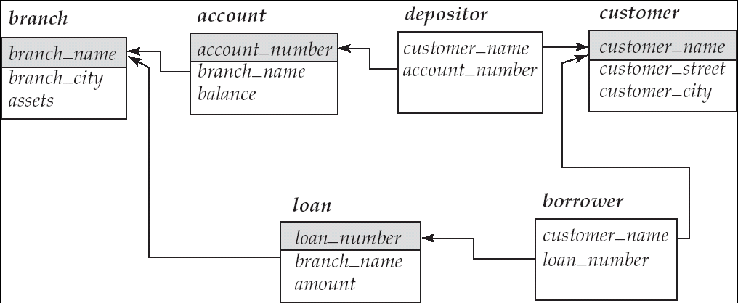
Foreign Keys
A relation schema may have an attribute that corresponds to the primary key of another relation. The attribute is called a foreign key.
E.g. customer_name and account_number attributes of depositor are foreign keys to customer and account respectively.
Only values occurring in the primary key attribute of the referenced relation may occur in the foreign key attribute of the referencing relation.
Schema diagram

Slide 21
Formal Definitions
Formally,
Given R(A1, A2, .........., An)
r(R) ⊂ dom (A1) X dom (A2) X ....X dom(An)
R(A1, A2, …, An) is the schema of the relation
R is the name of the relation
A1, A2, …, An are the attributes of the relation

Slide 22
Formal Definitions
Let R(A1, A2) be a relation schema:
Let dom(A1) = {0,1}
Let dom(A2) = {a,b,c}
Then: dom(A1) X dom(A2) is all possible combinations:
{<0,a> , <0,b> , <0,c>, <1,a>, <1,b>, <1,c> }
The relation state r(R) ⊂ dom(A1) X dom(A2)

